Slide 1
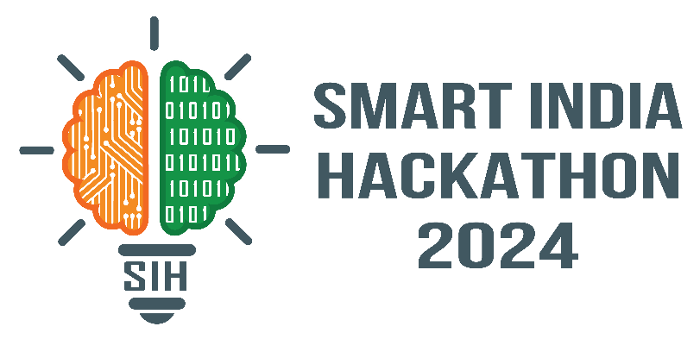
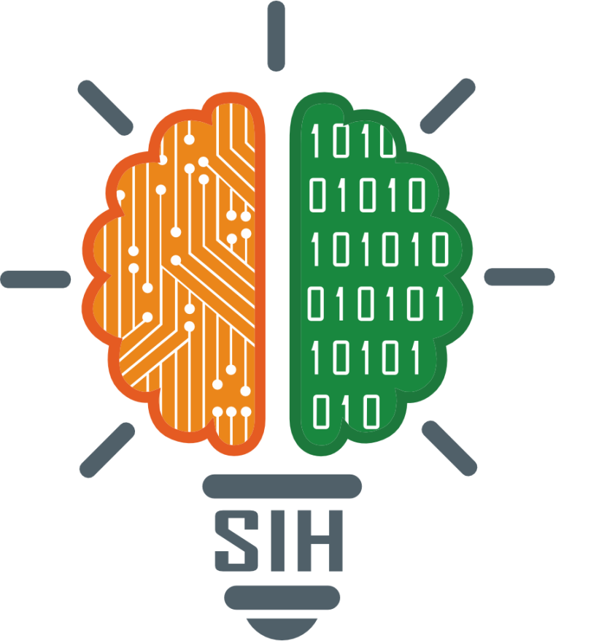
SMART INDIA HACKATHON 2024
TITLE PAGE
Problem Statement ID – 1691
Problem Statement Title- Adaption of 'Existing Command Area in Response to Shifting of Agricultural Practices.
Theme- Miscellaneous
PS Category- Software
Team ID- 4163
Team Name – Astra Codifiers

Slide 2
IDEA TITLE
Astra
Codifiers
Proposed Solution (Idea/Solution/Prototype
Purpose: Optimize water management for dams and reservoirs.
Data Acquisition: IoT sensors and remote sensing for continuous monitoring.
Predictive Analytics: ARIMA and machine learning for forecasting availability and demand.
Hydrological Modeling: SWAT and HEC-HMS for water flow and storage simulations.
Decision Support System (DSS): Real-time data visualization.
Scalable Infrastructure: Uses AWS and Google Cloud for robust processing.
User Interface: Intuitive dashboard for monitoring key metrics and generating progress reports.
Unique value propositions (UVP)
Real-Time Monitoring: IoT data for water levels and soil moisture.
Predictive Analytics: Forecasting with machine learning and ARIMA.
Hydrological Modeling: SWAT and HEC-HMS for water flow.
Decision Support: Actionable insights and visual reports.
Scalable Infrastructure: Cloud-based processing.
Adaptive Learning: Continuous model updates.
Problem resolution
Enhanced Water Management: Real-time monitoring of water levels, siltation, and soil moisture.
Climate and Demand Adaptation: Predictive analytics for forecasting water availability and agricultural needs.
Optimized Infrastructure: Hydrological models (SWAT, HEC-HMS) to improve water distribution.
Data-Driven Decision Making: Decision Support System (DSS) for real-time insights and recommendations.

Slide 3
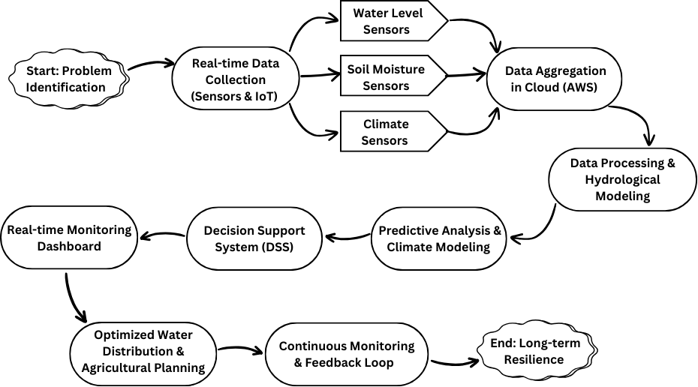
TECHNICAL APPROACH
Astra
Codifiers
Data Acquisition
IoT Sensors: Real-time monitoring
Remote Sensing: Drones, satellites
Data Integration: Live and historical data
Data Processing
Data Cleaning: Consistency, missing values
Hydrological Modeling: SWAT, HEC-HMS
Climate Modeling: ARIMA, machine learning
Predictive Analytics
Time-Series Forecasting: ARIMA, LSTM
Risk Assessment: Climate risks, infrastructure stress
Decision Support System (DSS)
Data Visualization: User-friendly dashboard
Scenario Analysis: Water management strategies
Real-Time Insights: Actionable recommendations
Software Development
Backend: Python, Node.js
Frontend: React, D3.js
Cloud Computing: AWS
Model Training and Updates
Machine Learning: Train, fine-tune
Continuous Learning: Regular updates

Slide 4
FEASIBILITY AND VIABILITY
Astra
Codifiers
Feasibility of idea:-
Technical Feasibility
Data Collection: Established IoT sensors (ARIMA/ LSTM)
Integration: Real-time data integration.
Infrastructure Readiness: Available IoT deployment infrastructure (AWS).
Implementation Feasibility
Pilot Testing: Phased deployment for validation.
Scalability: Easy expansion to additional sites.
Challenges:-
Data Quality
Model Accuracy
Integration with Existing Systems
Weather Conditions
Data Storage and Management
Strategies for overcoming it:-
Use high-resolution images and standard capture methods.
Employ transfer learning and frequent updates.
Develop flexible APIs.
Implement weather-adaptive algorithms.
Utilize scalable cloud storage.

Slide 5
IMPACT AND BENEFITS
Astra
Codifiers
Impact :-
Enhanced Water Management
Proactive Maintenance
Improved Planning
Reduced Manual Work
Lower Maintenance Costs
Informed Policies
Reduced Environmental Impact
Optimized Water Use
Local Community Benefits
Benefits:-
Sustainability
Cost Efficiency
Adaptability
Operational Efficiency
Climate Resilience
Agricultural Productivity
Community Benefits
Improved Decision Making
Enhanced Safety.

Slide 6
RESEARCH AND REFERENCES
Astra
Codifiers
Kumar, M., Kumar, M., & Chauhan, R. K. (2011). A review on decision support system for water resource development and management. Indian Journal of Dryland Agricultural Research & Development, 26(1), 8-15.
Serrat-Capdevila, A., Valdes, J. B., & Gupta, H. V. (2011). Decision support systems in water resources planning and management. In Efficient Decision Support Systems - Practice and Challenges (Edited by Chiang Jao). IntechOpen. DOI: 10.5772/16897.
Fluixá-Sanmartín, J., Altarejos-García, L., Morales-Torres, A., & Escuder-Bueno, I. (2018). Climate change impacts on dam safety. Natural Hazards and Earth System Sciences, 18(9), 2471–2488.
Lompi, M., Mediero, L., Soriano, E., & Caporali, E. (2023). Climate change and hydrological dam safety: A stochastic methodology based on climate projections. Hydrological Sciences Journal, 68(6), 745–763.

